Slide 1
PAVE Usability Testing 1

Slide 2
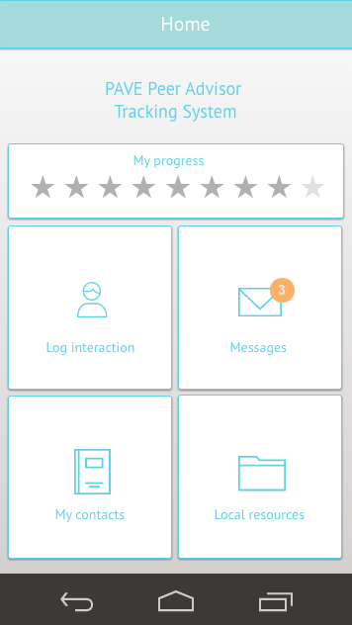

Slide 3
General impressions
“Simple, nothing confusing, nothing difficult”
“Easy. I like being able to log interactions by name, rather than by IDs. Messages is a good feature.”
“Beneficial to have local resources ready at hand, rather than inputting them in all myself - it’s helpful to see what resources are available and easier for me to refer them to help.”
“It’s nice to be able to log from my phone as well as on my computer - sometimes it’s hard to remember everything.”

Slide 4
Logging interaction
Q: “Say you just met one of your student veterans, and you want to make a log. Please log an entry for this student.”
Unclear call-to-action
Possibly put “Log interaction” at top of screen.
Consider consolidating all Student Veteran related interactions into “My contacts”

Slide 5
My contacts
Q: “Where would you go in the app to ask a question?”
Ambiguity of whose info can be found under “My contacts”
Possibly change:
“My Contacts” to “My peers / Peers / Mentees”
“Messages” to “PAVE messages”

Slide 6
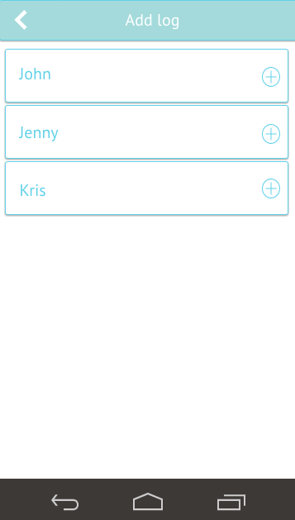
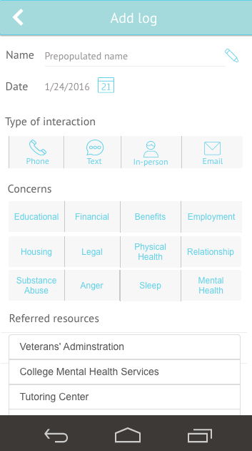
Logging multiple entries
Some PAs interact with peers mostly through mass emails
Manually entering identical information for each peer is repetitious
Consider adding ‘Select all peers’ feature in the ‘Add log’ screen

Slide 7
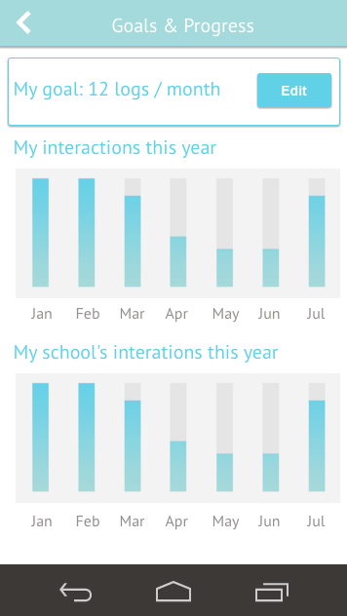
Logging interaction
Q: “How do you feel about setting goals and measuring your progress for interaction logs”
“I definitely think it's good to keep you honest, so you're not slacking or just being lazy. I think it's a good feature to definitely have that. And then it's cool to compare it to your school's interactions, to see where you're at compared to where everyone else is that, and if you're way behind, it'd be cool to meet up with the other pave advisor and ask what they're doing differently”
“It’s something good to do and see. I have a general idea of what’s going on, but seeing a visual would be beneficial.”

Slide 8
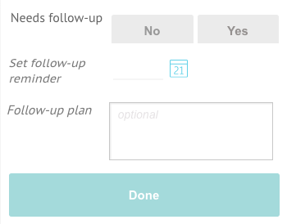
Additional features
Q: “Anything else you’d like to see?”
“I have a lot going on..it’d be nice to set up a follow-up reminder. If it could link to google calendar it would be helpful.”
“[Notifications] would be helpful for me, especially when you’re busy, because sometimes you totally forget about it”

Slide 9
Questions
How will the new process of entering a new Peer (student veteran) into the tracking system differ from the current method, where PAs manually create accounts?
For new Peers, should PAs input information that goes beyond the traditional interaction log?

Slide 10
https://live.uxpin.com/14155e0cb08682c2d38ac7c5aa0ab875f58027bb#/pages/34878181

